Slide 1
CS 392 - Capstone Project
02 - Final Phase

Slide 2
GROUP MEMBERS
Aakash Sinha
Deep Parikh
Karanjit Singh Gill
Mohit Raj
NVS Abhilash
Prateek Agarwal
TEAM MEMBERS

Slide 3
AGENDA
Overview of O₂
Demo
Objectives
Work Done
Technologies Used
ElasticSearch
Semantic Search
Future work
References

Slide 4
Overview

Slide 5
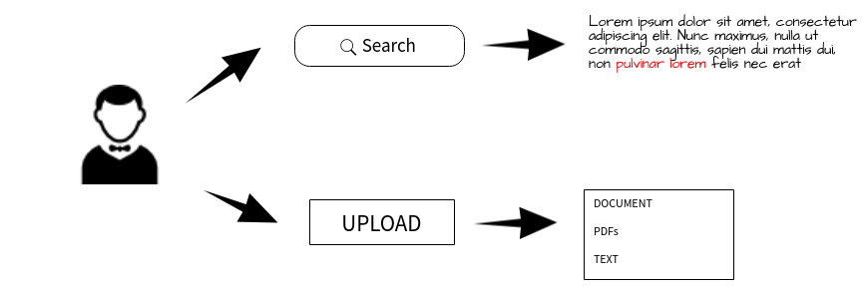
O₂

Slide 6
How about a Demo first!

Slide 7
Objectives

Slide 8
To Develop a semantic search engine which uses ElasticSearch capabilities for searching documents, stored remotely
To provide a minimalist UI which has upload and search options
The Upload function helps the user to upload all kinds of documents and store them in the local database.
The Search function implements Elasticsearch and query expansion to increase the size of retrieved documents.
It will be used as a part of an ongoing live project at NIIT Ltd.

Slide 9
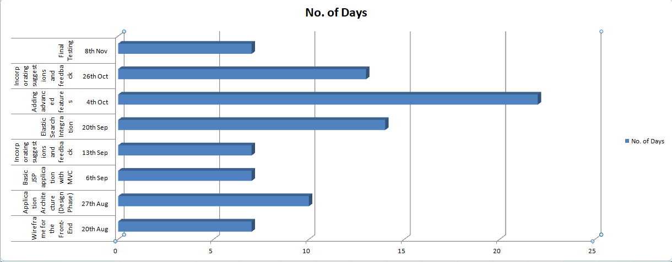
Project Timeline : Gantt Chart

Slide 10
FEATURES
Document Search Engine.
Semantic Search Capabilities.
User can upload documents of supported format.
Can search .pdf, .doc, .xls, .rtf, .html, .odt, etc .
Can work on both internet and intranet.

Slide 11
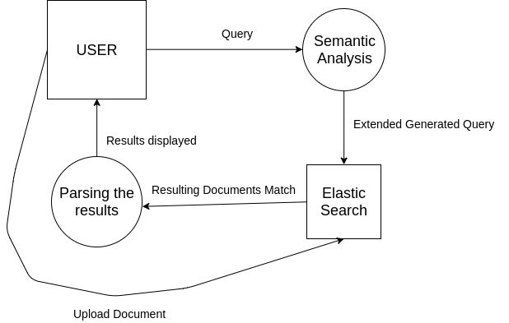

Slide 12
Architecture Overview
Developed a dynamic web application in Eclipse framework.
Based on Java Server Pages (JSP) and Java Servlets.
Handled Elastic Search in java for document indexing, searching and retrieval.
Semantic search is implemented using word2vec and gensim library in Python.

Slide 13
Progress so far...

Slide 14
Work Done So Far (Phase I and Phase II)
Phase I
Wireframe design
Data Flow Diagram
JSP - Servlets architecture
Front Controller
Research on Elastic Search.
Research on Semantic Search.
Phase II
Back controller to handle API calls to Elastic Search Engine and its capabilities.
Semantic search implemented using word2vec.

Slide 15
Roles
Team Members | Roles
Aakash Sinha Karanjit Singh Gill Mohit Raj | UI / UX
Aakash Sinha Karanjit SIngh Gill NVS Abhilash | Elastic Search
Deep Parikh NVS Abhilash Prateek Agarwal | Semantic Search
Deep Parikh Mohit Raj Prateek Agarwal | Java Servlet

Slide 16




TECHNOLOGIES USED
NLTK
Java Server Pages
Java Servlets
Elastic Search
GitHub for project collaboration
Trello & Slack for project management

Slide 17
Implementation of ElasticSearch

Slide 18
ElasticSearch
It is accessible from RESTful web service interface.
Uses schema less JSON (JavaScript Object Notation) documents to store data.
Built on Java programming language, hence it is cross platform.

Slide 19
Creating the Index
Index − It is a collection of different type of documents and document properties.
Type/Mapping − It is a collection of documents sharing a set of common fields present in the same index.
Document − It is a collection of fields in a specific manner defined in JSON format.
Replicas − Elasticsearch allows a user to create replicas of their indexes and shards.

Slide 20
ElasticSearch RESTful API
search( ) :
GET http:// server:port /index/type/ _search?q={query}
1 index
2 types :
text
doc

Slide 21
ElasticSearch RESTful API
index( ) :
PUT http:// server:port /index/type with request JSON body
JSON body
{
“authorName” : { name }
“content” : { content}
“Timestamp” : { time }
}

Slide 22
Semantic Search

Slide 23

Semantic Search using Query Expansion
We pad the queries with similar meaning words from the corpus to increase the length of search query and subsequently increasing the semantic search size for a user
“High Level Java”
“Advanced Level Java”

Slide 24
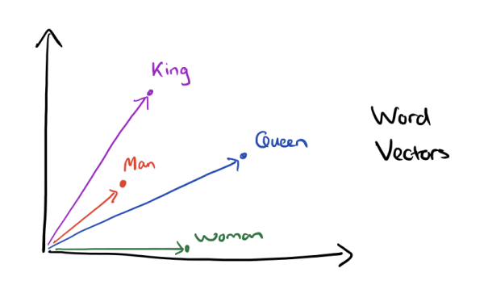
Efficient Estimation of Word Representations in Vector Space
Word2vec helps in predicting the context of the words
Why not use synonyms instead?
Thresholding is possible

Slide 25
O2 User Interface

Slide 26
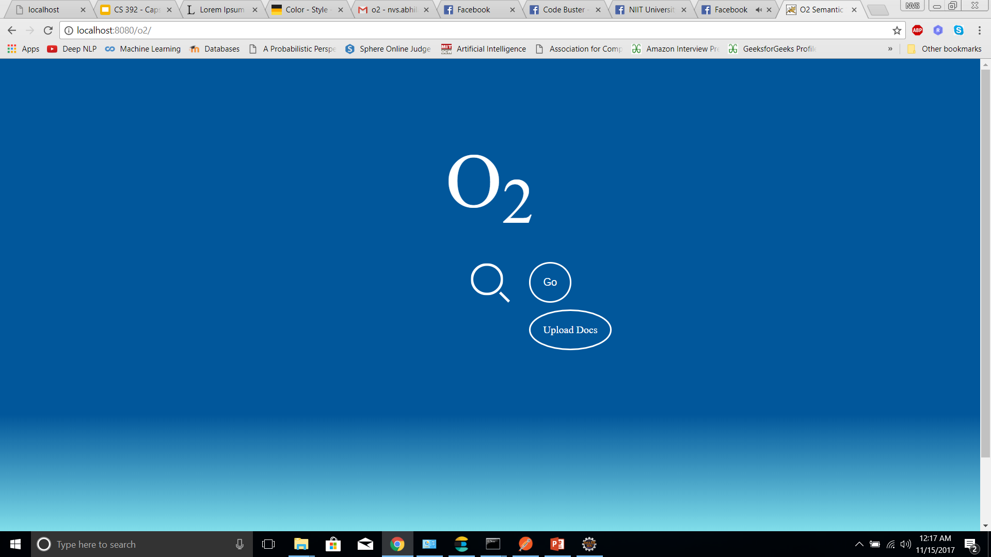
The O2 UI : Landing Page

Slide 27
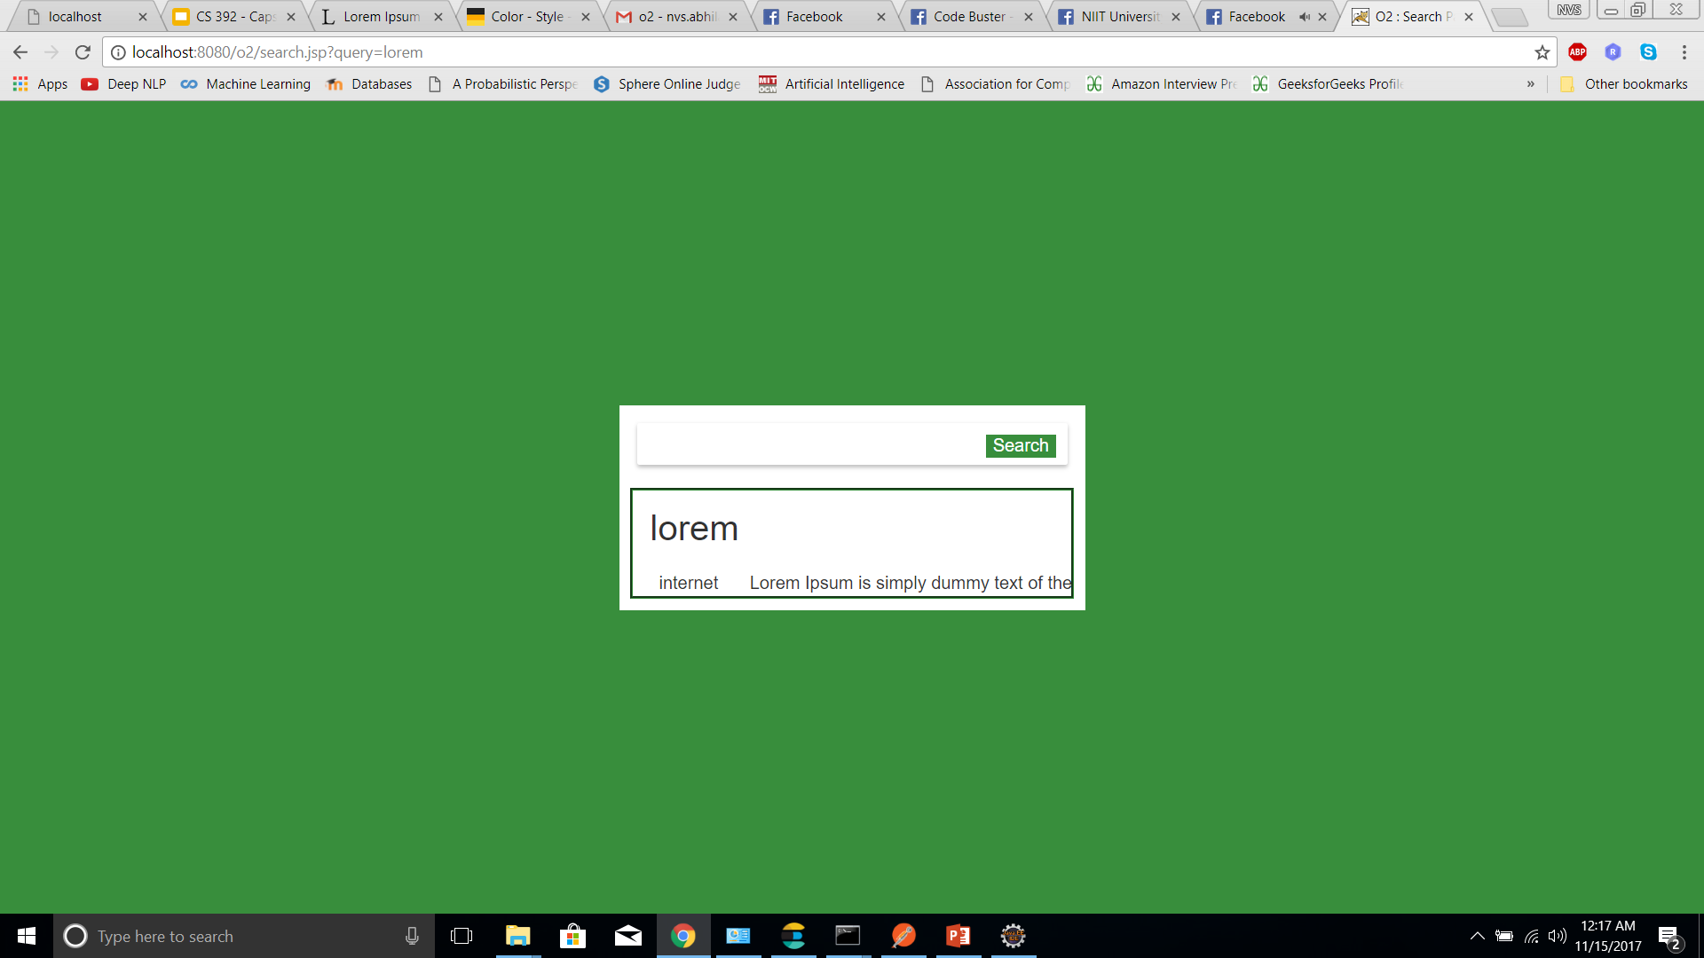
The O2 UI : Search Result Page

Slide 28
Future Work
Support multiple file formats
Experiment with other Semantic Search functions like LSA.

Slide 29
References
Efficient Estimation of Word Representations in Vector Space. (Tomas Mikolov, Kai Chen, Greg Corrado, Jeffrey Dean, 2013)

Slide 30
Thank You!

